Slide 1

Stanford Pre-Medical Asian Pacific American Medical Student Association (APAMSA)
Interest Meeting
Wednesday, April 16th

Slide 2
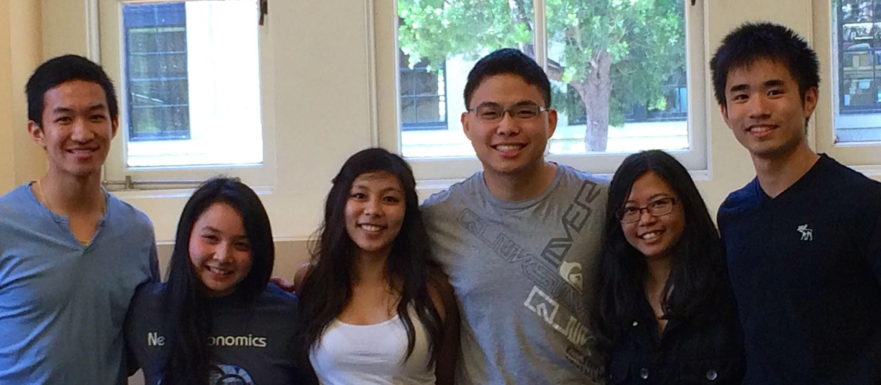
WHO WE ARE

Slide 3
What is ?
National organization of medical and pre-medical students
Addresses unique challenges of APIA communities
Promote health of the APIA community
Formed because “issues of APIA health were largely ignored by existing organizations”

Slide 4
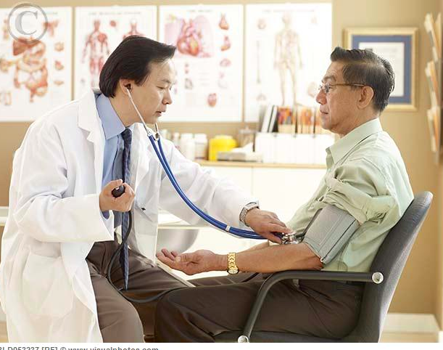
Our Mission
Foster a community among API pre-meds and students interested in API health issues
Address and spread awareness of API health disparities
Notes:
First API-interest pre-med org on campus; address my motivations for founding the organization
There are 7 pre-med chapters nationwide and nearly 70 medical school chapters nationwide
Address API health disparities and difficulties APIs face in education, healthcare, the workforce, and society as a whole.
Address WHY APIs face health disparities (failure to seek medical care) and why they face difficulties in education, workforce, society (bamboo ceiling)

Slide 5
API Health Disparities
Notes:
A: Vietnamese
Source: Fred Hutchinson Cancer Research Center
Notes: But even if you’re not Vietnamese, it is extremely important for you to get screened for HBV! Vaden provides free screening, and if you test positive, you will be given a vaccine. HBV is infectious and its symptoms are difficult to detect, sometimes even non-existent. APAMSA members will collaborate with Stanford’s Team HBV chapter to host and volunteer at events advocating widespread HBV education and screening! Also, as a fun fact, the Jade Campaign advocating HBV awareness started at Stanford in

Slide 6

Hepatitis B Virus (HBV)
HBV affects 1/10 Asians and is a direct cause of liver cancer.
Vietnamese have the highest incidence rate
Notes:
*APAMSA will collaborate with Team HBV with screening events and spreading awareness/educating the API community.

Slide 7

Cancer
After lung cancer, colorectal cancer is most common for APIs
Breast cancer is one of the leading causes of death in Asian women.
Notes:
*APAMSA will collaborate with the Asian American Cancer support network to reach out to patients and provide support.
The screening rates for CRC are extremely low despite its common occurrence. Programs increasing awareness and availability of screening tests could help lower CRC mortality among Asian Americans.
Breast cancer is one of the leading causes of death in Asian women.
Source: http://www.pfizer.com/files/products/cancer_in_asia.pdf

Slide 8
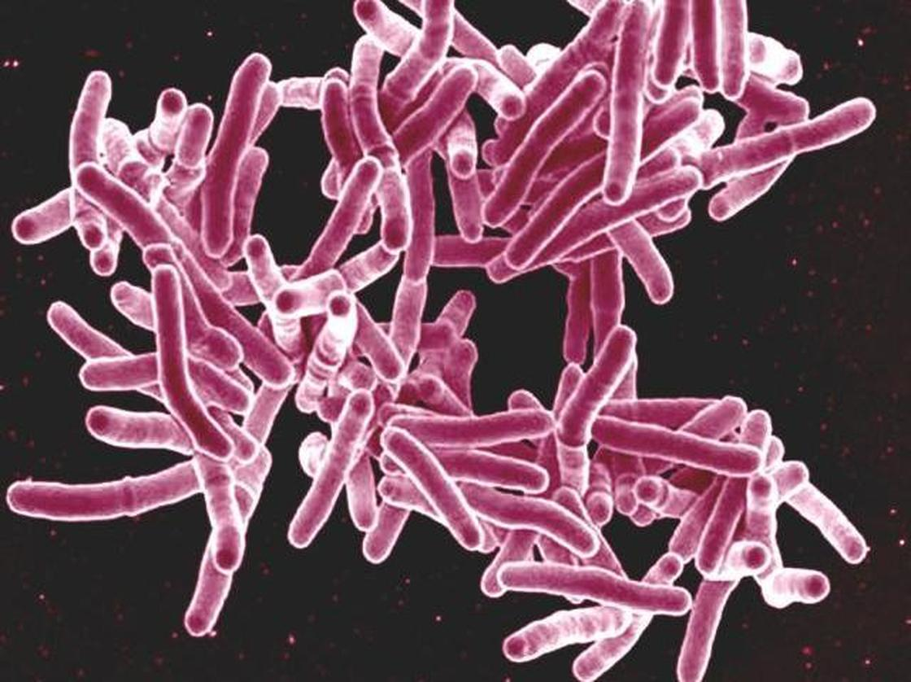

Tuberculosis
API community has the highest rate of tuberculosis of any racial or ethnic population.
Asia alone accounts for 60% of new cases globally
Notes:
*APAMSA will provide educational events and we also hope to hold an event that provides the API community a way to receive free TB tests
Asian Americans/Pacific Islanders have the highest rate of tuberculosis of any racial or ethnic population - 33 per 100,000 compared to the second highest of 12 per 100,000 in non-Hispanic blacks. As students, we are often mandated to get routine TB tests, and it’s not very expensive and generally not a big deal. However, in rural areas (especially in Asia) that do not have access to healthcare, the disease remains a huge problem. We already have readily available vaccines; the next logical step would be to implement a global initiative for a viable delivery system to the underpriviliged.

Slide 9

Bone Marrow Registry
~10% of Asian American donors make up the National Bone Marrow registry
Notes:
APAMSA will collaborate with other organizations on campus (i.e. Lambda Phi Epsilon fraternity) to hold Bone Marrow Drives and awareness events
Nearly 10%, 18000. This is very stark considering how there are more than 720,000 Asian potential
bone marrow donors. To put things in perspective, think about how over 7 million whites are part of the registry but Asians are not. APAMSA hopes to educate its members and the community about the bone marrow registry and bone marrow donation, in order to encourage more people to become donors to save lives.

Slide 10

Depression in API Students
Lack of acculturation to Western traditions
Parental pressure
Lack of familial support network
Model minority label
Racial identity conflict
Stigma in API culture
Notes:
API undergrads have a significantly higher incidence of depression than other ethnic groups. They are also among the underrepresented in those who seek care.
*APAMSA hopes to provide more resources on campus for API students who may be suffering from depression or the issues listed, whether it be open discussions or fostering a sense of belonging for these students
Additionally, providing more educational resources for immigrant parents who may not be aware of the western culture and college life can help bridge the gap between first generation APIs and their parents (i.e. an event at NSO, Admit Weekend, or Parents Weekend that addresses this issue and targets immigrant parents)

Slide 11
Our Teams

Slide 12
Our Teams
Publicity & Outreach
Chair: Jason Kung
Events Management & Coordination
Chairs: Cheylene Tanimoto, Jessica Shen, Stephen Ahn
Program Development
Chairs: Jason Khoo, Steven Chen
(Faculty Advisor: Dr. Sang-ick Chang, MD, MPH)

Slide 13

Publicity and Outreach
Disseminate APAMSA’s info and message to others on campus
Develop flyers/ads to promote our organization and events
Maintain strong relationships
with faculty, med school,
and more

Slide 14

Events Management & Coordination
Coordinate and supervise a variety of events
Community Service Subcommittee: give back to the local community (medical & non-medical)
Medical and Professional Subcommittee: provide learning experiences for members (i.e. medical workshops)
API Health Disparities Subcommittee: address API health disparities (i.e. awareness campaigns)

Slide 15

Program Development
Develop medical/community service programs
for members
Mentorship programs for both pre-med students and local youths
Clinical volunteer programs

Slide 16
What We Do:
Workshops/panels/events for premed community
API health disparity awareness events
High school mentoring programs
Mentoring program with Stanford Medical students
Community outreach
Boba outings
Notes:
We are currently working on setting up mentoring programs (1) for high school students to encourage them to pursue careers in medicine and (2) with medical students so we can gain some knowledge on what is to come, so we with be both mentors and mentees. We are also hoping to have some outreach to the greater API community with emphasis on education of health disparities. Furthermore, we are hosting several workshop/activities this quarter that would benefit anyone in the premed community.

Slide 17
Spring Quarter Events

Slide 18

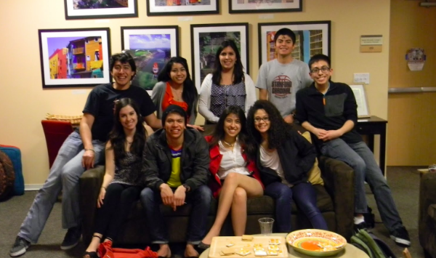

Events for Spring Quarter
Cancer and the API Community
Asians in Healthcare: Career Pathways Panel
Ethnic Pre-Med Mixer
Notes:
On [insert date] we will be hosting an event in collaboration with the Asian American Cancer Support Network. At this event, we will be making care baskets for patients diagnosed with cancer and their families and we will hear from the founder of the Asian American Cancer Support Network.
We welcome NEW ideas from those interested in joining us!

Slide 19
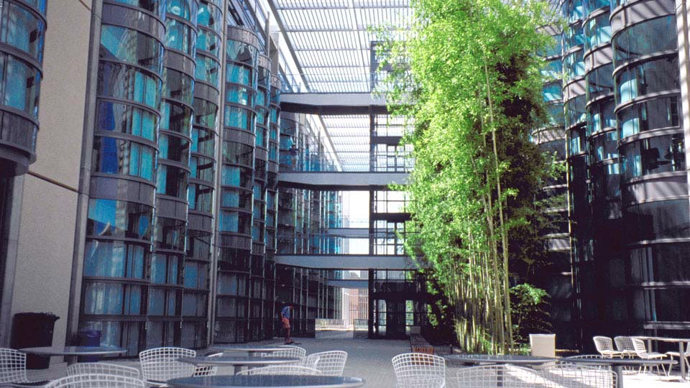
Anatomy Lab Tour Event
Date: May 13, 2014
Time: 1pm-3pm
Location: CCSR
Notes:
The Center for Clinical Sciences Research Building is located in the medical school. We have the benefit of taking students on a guided tour through the facilities. CONFIRMED EVENT

Slide 20
New Partnerships
Stanford Medical Scribe Fellowship Program
Notes:
Scribe program headed by Dr. steven lin
Ingenius prep discount for our members

Slide 21
Poll Questions
Pull out your phones and text answers to: 22333
Go to www.pollev.com and download the free app!

Slide 22
What’s your general interest in APAMSA?
343556 - finding a premed community
343577 - getting involved in the API community on campus
343581 - discovering other premed opportunities
343694 - join APAMSA as part of the leadership board
text a code to: 22333

Slide 23
What sort of events are you most interested in seeing us host?
86630 - study sessions with snacks and boba of course
86695 - speaker panels about the pre-med journey
343506 - events related to API health disparities both locally and internationally
343537 - social and stress relief nights
343548 - other -- I'll send you my ideas!
text a code to: 22333

Slide 24
What initiatives are you most interested in pursuing with APAMSA?
343784 - medical/clinical opportunities for pre-med students
343791 - spreading awareness of API health disparities
343805 - developing programs/partnerships with on campus and local community organizations
343866 - building a stronger pre-med community on campus
437063 - other -- I'll send you my ideas!
text a code to: 22333

Slide 25
Get Involved!
We’re looking for people who are excited and passionate about the organization!
Learn more about how you can shape the future of Stanford Pre-Med APAMSA by visiting:
http://premed-apamsa.stanford.edu where you can find our Intern Application!
Notes:
We are recruiting for Interns to join our Core Team!!!!!!

